Slide 1

Expedited Deposits
Reviewed: 10/27/2023
Clients can make one-time deposits into their GH account with a debit card
This feature allows clients to quickly increase their balances, making additional funds available for real-time settlement activity
Using Global’s client portal to initiate the deposit, clients can provide their account information, enter their debit card details and receive a confirmation that the deposit was authorized.
The consumer is the only party authorized to make a deposit to their account.
Global accepts all debit cards issued by Visa, Mastercard, or Discover.
Global’s deposit maximum is $20,000.00. The consumer’s bank may have different transaction limits. The consumer may want to confirm that their submission is within their bank’s limits.
The consumer will know right away if the deposit is accepted or declined.
Expedited deposits process every day. If submitted before 7:00 p.m. central standard time (CST), they post to consumer accounts immediately. If submitted after 7:00 p.m. CST, they post the following day.
The consumer can cancel a debit card transaction until 5:00 p.m. CST of the day they submitted it.

Slide 2
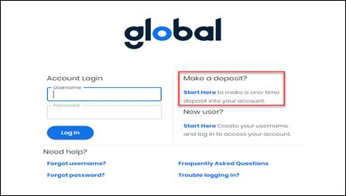
The consumer can start a one-time deposit from the Account Login page.
• Look underneath Make a deposit? and click Start Here.

Slide 3
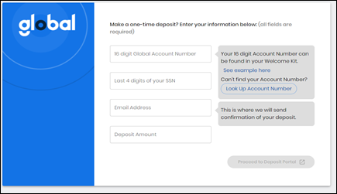
The One-Time Deposit page opens. The consumer must verify their identity, confirm their email address, and provide a deposit amount. If the consumer knows their 16-digit account number, they can verify their identity with the account number and the last four digits of their Social Security number (SSN).
To make a one-time deposit, enter your 16-digit account number, the last four digits of your SSN, your email address, and the deposit amount. Then click Proceed.
If you don’t know your account number, you can look it up in your welcome letter
If you can’t find your account number, click Look Up Account Number. See Verify identity without an account number.
If you are not able to locate your account number, your CLG agent can provide that information.
To view information about one-time deposits, click One-Time Deposit Info.

Slide 4
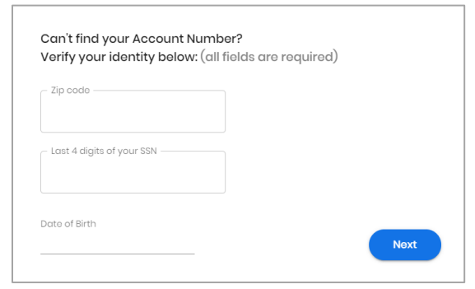
Verify identity without an account number
If the consumer can’t find their 16-digit account number, they can verify their identity with other identifying information. When the consumer clicks Look Up Account Number, a Can’t find your Account Number page opens.
1. Enter your ZIP code, your date of birth, and the last four digits of your SSN.
2. Click Next.

Slide 5
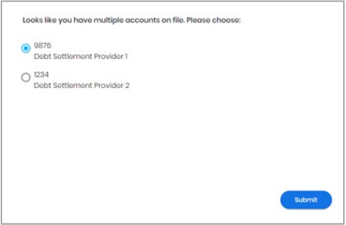
Select an account when multiple are on file
If the consumer tries to verify their identity and multiple accounts on file match their information, a list of possible accounts appears. The website only displays accounts if all three pieces of information match (ZIP code, date of birth, and last four digits of an SSN).
1. Select your account.
2. Click Submit.

Slide 6
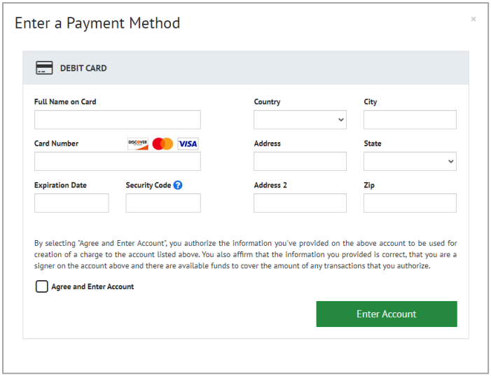
Enter a payment method
After the consumer verifies their identity, they must provide a debit card to make the one-time deposit. The Payer Express website opens with the Enter a Payment Method dialog.
Enter your debit card information, including name on card, card number, expiration date, security code, and billing address.
Read the disclosure and select Agree and Enter Account.
Click Enter Account.

Slide 7
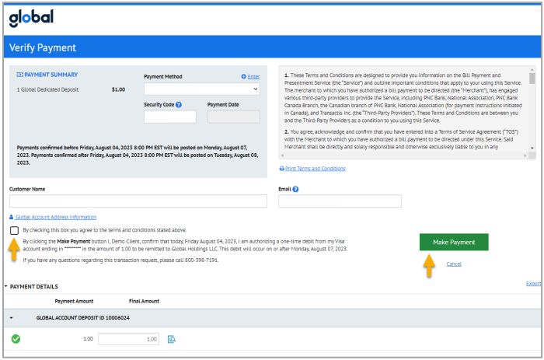
Verify and make the debit card payment
After the consumer enters their debit card information, they agree to Global’s terms and conditions and submit the payment. They have the opportunity to modify the payment information if needed.
Review the payment summary, contact information, and payment details.
    To export the payment details to a CSV, look next to Payment Details and click Export.
    To print an invoice, click the View Invoice button. Then click Print.
Update information if needed.
    To change the payment method, look under Payment Summary and click Enter.
    To change your email, use the Email field.
    To change the payment amount, use the Final Amount field.
Agree to the terms and conditions. Select the checkbox next to “By checking this box you agree.”
Click Make Payment.

Slide 8
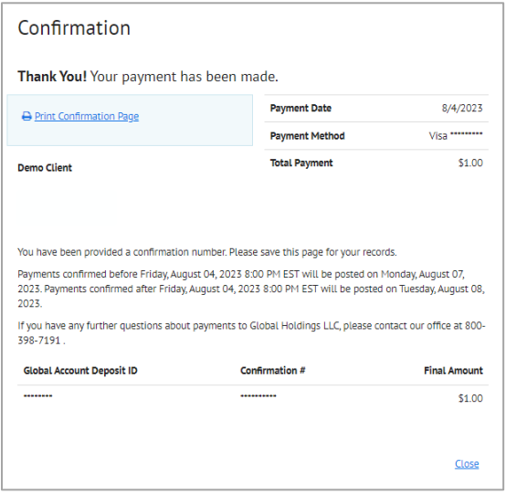
Confirm the deposit
When the consumer submits the debit card payment, the website displays a confirmation page and sends the consumer a confirmation email.
To print the confirmation page, click Print Confirmation Page.

Slide 9
Need to know
The client is the only party authorized to make a deposit
Visa, Mastercard and Discover debit cards are accepted
Posted deposits are visible on Transactions and Deposit History screens in the Client Portal
Expedited deposits do not process on Saturdays, Sundays, or Holidays. The deposit date will be the next business day
The client will know right away if the transaction is accepted/declined, just like any online purchase
A deposit will post to the client’s account immediately upon completion, no waiting period
Minimum transaction is $1 and maximum is $20,000. Deposits larger than the maximum can be achieved through multiple transactions
Deposits submitted after 7pm (CST) or on weekends/holidays will post the following business day

